Slide 1
Baseband Signal Transmission
I

Slide 2
Baseband signal transmission
In this chapter we consider several baseband digital modulation and demodulation technique.
We mainly focus on binary modulations. We also discuss the optimum receivers for these different signals and consider the evaluation of their performance.

Slide 3
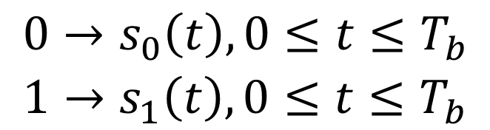
Binary signal transmission
In a binary communication system, binary data of a sequence of 0’s and 1’s by means of two signal waveforms, i.e., s₀(t) and s₁(t).
$$\begin{matrix}0→s_{0}\left(t\right),0≤t≤T_{b} \\ 1→s_{1}\left(t\right),0≤t≤T_{b}\end{matrix}$$
Notes:
卷积表达式，

Slide 4

Binary signal transmission
Consequently, after passing through AWGN channel, the received signal is:
The task of the receiver is to determine whether a 0 or 1 was transmitted. If the receiver is designed to minimized the probability of error, it is called the optimum receiver.
Two optimum receivers for AWGN: signal correlator（相关器） and matched filter（匹配滤波器）.
Notes:
卷积表达式，

Slide 5
Binary signal transmission
Signal correlator:
Notes:
卷积表达式，

Slide 6
Binary signal transmission
Signal correlator:
The output at t=T_{B} when s₀(t) is sent:
For AWGN, the noise n_{i} is Gaussian distributed with mean of zero and variance of
Notes:
卷积表达式，

Slide 7
Binary signal transmission
Match filter:
Notes:
卷积表达式，

Slide 8
Binary signal transmission
Detector:
The detector observe the correlator or matched filter output and decides on whether the transmitted signal waveform is either s₀(t) or s₁(t).
Optimum detector:
Comparing r₀ or r₁. If r₀> r₁, it decides 0 is transmitted.
The probability of error:
Noise spectrum density:N₀/2
Notes:
卷积表达式，

Slide 9
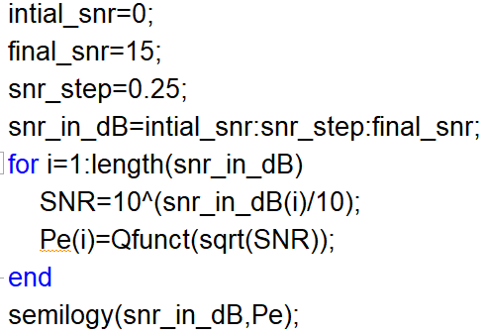
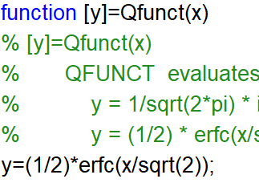
Binary signal transmission
Problem 5-3
Generate the probability of error versus the SNR E/N₀:
Notes:
卷积表达式，

Slide 10
Binary signal transmission
Problem 5-4: Monto Carlo simulation of a binary communication system
Notes:
卷积表达式，

Slide 11
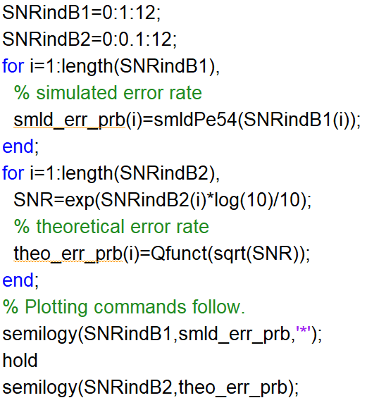
Binary signal transmission
Main script:
Notes:
卷积表达式，

Slide 12
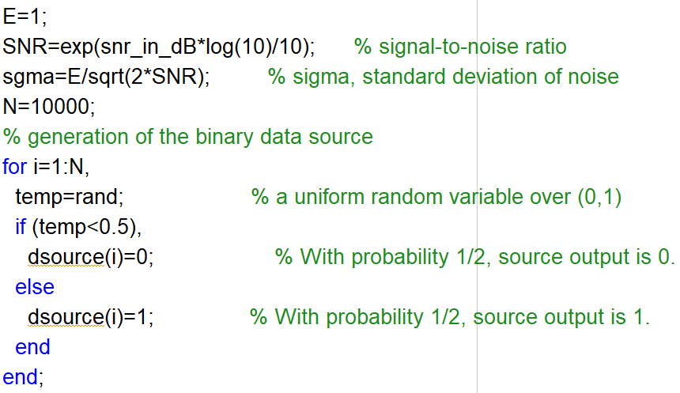
Binary signal transmission
Function:smldpe54()
Noise variance:
SNR: E/N₀
Notes:
卷积表达式，

Slide 13
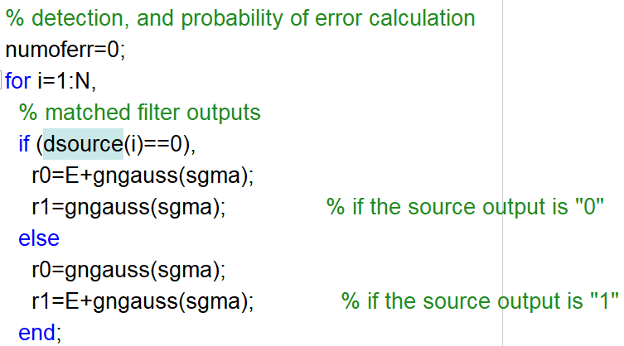
Binary signal transmission
Function:smldpe54()
Notes:
卷积表达式，

Slide 14
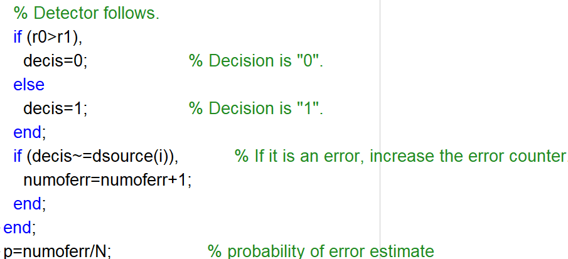
Binary signal transmission
Function:smldpe54()
Notes:
卷积表达式，

Slide 15
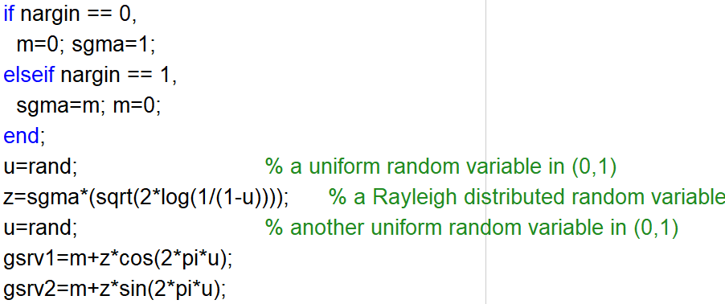
Binary signal transmission
Function:gngauss(), we can also directly use randn()
A=a+bj= |A|*e^(jθ),
|A| is Rayleigh distributed
Notes:
卷积表达式，

Slide 16
Other Binary signal transmission
The transmission scheme desciribed before is based on the use of orthogonal signals.
Antipodal signals:
One signal wave is negative of the other.
Notes:
卷积表达式，

Slide 17
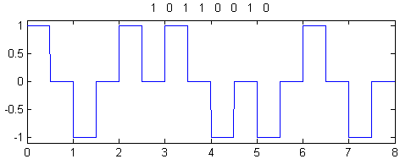
Other Binary signal transmission
Notes:
卷积表达式，

Slide 18
Other Binary signal transmission
The optimum receiver for AWGN:
Notes:
卷积表达式，

Slide 19
Binary signal transmission
The output at t=T_{B} when s₀(t) is sent:
For AWGN, the noise n_{i} is Gaussian distributed with mean of zero and variance of
Optimum detector:
If r> 0, it decides 0 is transmitted.
The probability of error:
Notes:
卷积表达式，

Slide 20
Binary signal transmission
Problem 5-5: Monto Carlo simulation of a binary antipodal communication system
Notes:
卷积表达式，

Slide 21
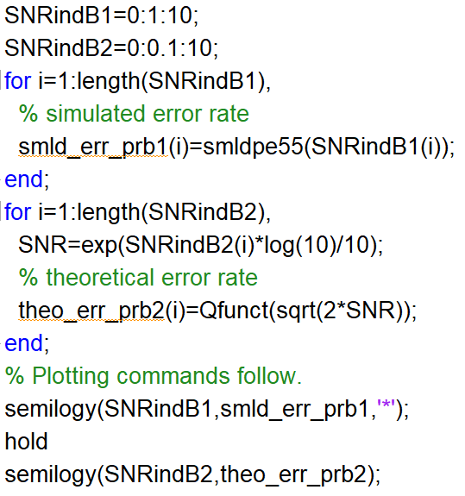
Binary signal transmission
Main script:
Notes:
卷积表达式，

Slide 22
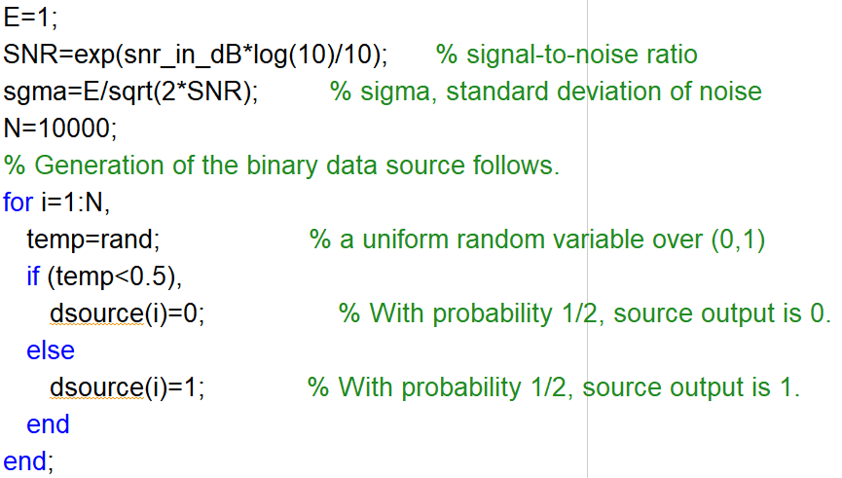
Binary signal transmission
Function:smldpe55()
Noise variance:
SNR: E/N₀
Notes:
卷积表达式，

Slide 23
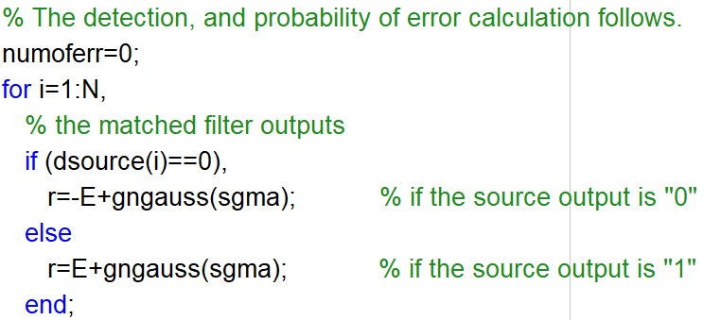
Binary signal transmission
Function:smldpe55()
Notes:
卷积表达式，

Slide 24
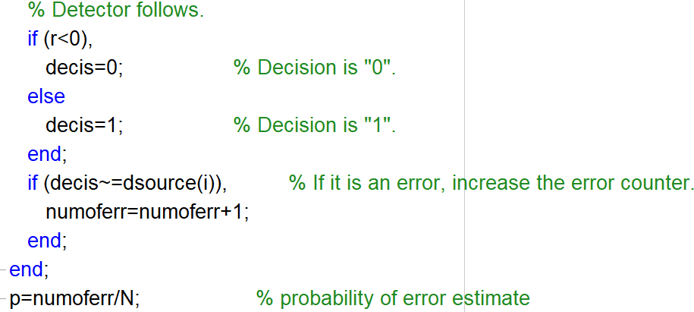
Binary signal transmission
Function:smldpe55()
Notes:
卷积表达式，

Slide 25
Other Binary signal transmission
On-off signals:
No signal is transmitted for 0. A signal waveform s(t) is transmitted for 1. The received signal under AWGN:
Notes:
卷积表达式，

Slide 26
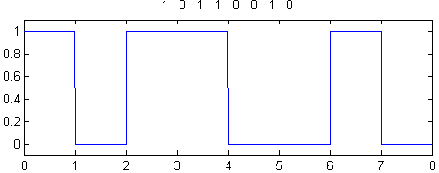
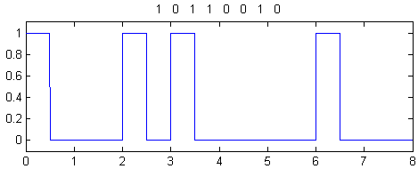
Other Binary signal transmission
Notes:
卷积表达式，

Slide 27
Other Binary signal transmission
The optimum receiver for AWGN:
Notes:
卷积表达式，

Slide 28
Binary signal transmission
The output at t=T_{B} when s₀(t) is sent:
For AWGN, the noise n_{i} is Gaussian distributed with mean of zero and variance of
Optimum detector:
If r< E/2, it decides 0 is transmitted.
The probability of error:
Notes:
卷积表达式，

Slide 29
Binary signal transmission
Problem 5-6: Monto Carlo simulation of a binary on-off communication system
Notes:
卷积表达式，

Slide 30
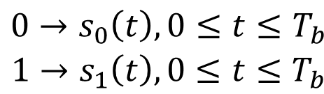
Signal constellation diagrams for binary signals
The aforementioned signals can be characterized geometrically as points in ‘signal space’
$$\begin{matrix}0→s_{0}\left(t\right),0≤t≤T_{b} \\ 1→s_{1}\left(t\right),0≤t≤T_{b}\end{matrix}$$
Notes:
卷积表达式，

Slide 31
Signal constellation diagrams for binary signals
P-5.7: The effect of noise on the performance of a binary can be shown by constellation diagrams.
If 0 is transmitted, the constellation of the received signal is
n₀,n₁ is Gaussian with mean of zero and variance of N₀/2.
Otherwise,
Notes:
卷积表达式，

Slide 32
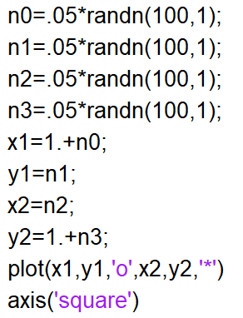
Signal constellation diagrams for binary signals
P 5.7: The effect of noise on the performance of a binary can be shown by constellation diagrams.
Notes:
卷积表达式，

